Slide 1

AgriLearn One Stop Learning Web Application For Farmers

Slide 2

Background Of Project
Major Problems faced by Farmers | Solution provided by our website
Lack of Information | Information about crops, seeds, etc.
Language Barrier. | Available in many regional languages.
Scattered Data. | Available under single website.
No proper news. | Integrated News Portal from trusted sites.
Less information about schemes, insurance ,etc. | Provides real-time data of schemes and insurance, etc.
No weather knowledge. | Provides weather forecasting.
Lack of cultivation knowledge. | Provides crop recommendation.
Lack of crop disease knowledge. | Provides disease information by detection.

Slide 3
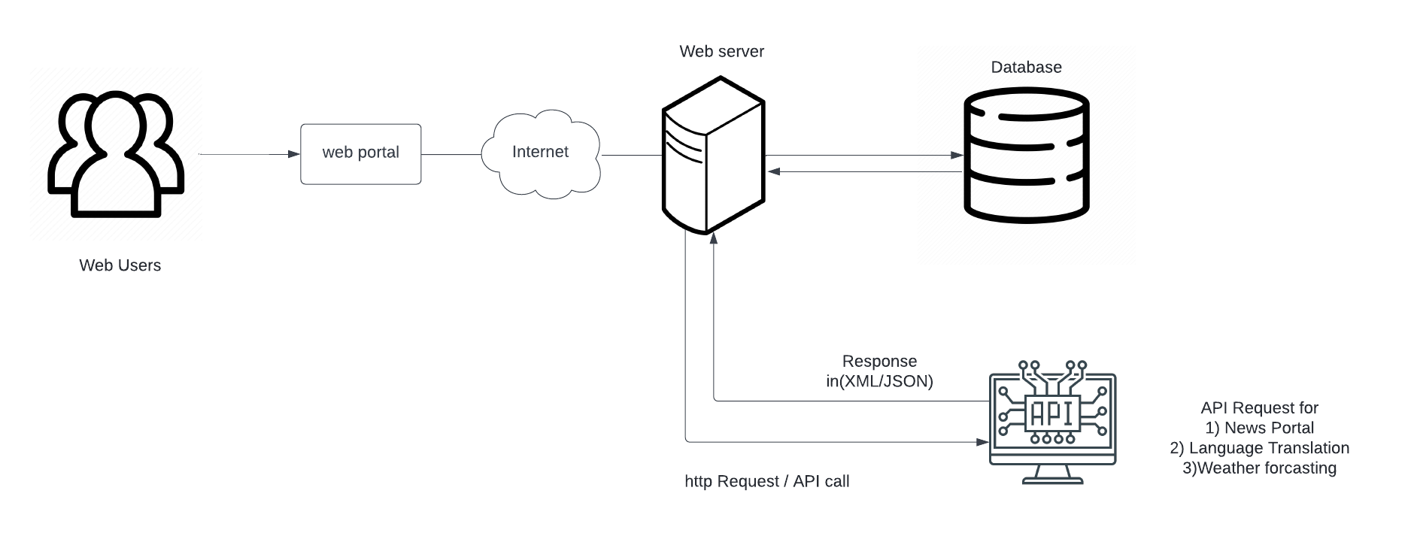
SYSTEM ARCHITECTURE

Slide 4
Working Of Website
There are many services on the website which works differently.
Language Translation, Weather Forecasting using API.
Crops and Seeds Information.
Crop Recommendation , Disease Detection.
News Portal Integration using API..
All other real-time info is fetched from other websites using API’s.
Many other features are managed according to need using Database or API’s.

Slide 5








TECH STACK
Frontend:
Backend:
Database:

Slide 6
TEAM TROUBLESHOOTERS
Aishwarya Kyasari – Backend Handling , Frontend Handling.
Tanya Jain – Frontend Handling , Backend Handling.
Suksham Sharma – Research, Analysis and Testing, Frontend Handling.
Anuj Somani – Database Handling , Frontend Handling.

